Slide 1
CS891: Web Archiving Seminar
Dissertationpalooza Presentation
Hussam Hallak

Slide 2
Unsupervised Small-World (USW)
A Framework for Web Object Self-Preservation
Charles L. Cartledge
Ph.D. in Computer Science
Old Dominion University
Norfolk, VA
August 2014

Slide 3
What is the question?
How to preserve digital data for the long term?

Slide 4
Why is it important?
Our personal and cultural heritages are moving from analog to digital.
Photo albums to image files in folders
Cassette to CD, DVD, ...etc
VCR to CD, DVD, ...etc

Slide 5
What have others done to solve the problem?
Large archive/institutional centric approaches.
Institutions can and will fail.

Slide 6
What will Dr. Cartledge do to solve the problem?
Permeate the digital objects with the desire to preserve themselves and provide an environment where they can thrive
USW is where graph theory, emergent behavior, and preservation meet.

Slide 7
How to prove that the problem is solved?
The autonomic migration of digital/web objects from host to host and from one form to another.

Slide 8
What is the conclusion?
Digital data preserves itself and outlives the people and organizations that created them.

Slide 9
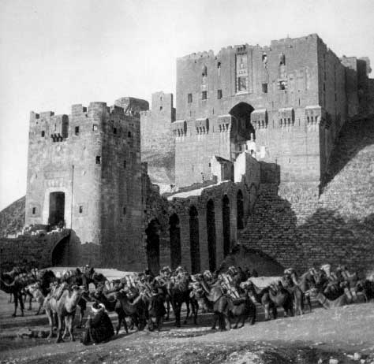
Keeping something safe in the bad old days!
Aleppo, gateway to castle
Constant care & attention
Don’t touch it
Keep from the sun
Keep from moisture
Keep from other elements
Keep from insects
Keep from animals
Keep from kids
http://www.kacmac.com/cities/images/Aleppo/OldCaravaCitadel.jpg

Slide 10

Keeping something safe in the digital era!
Refreshing: Preserving bits sequence.
Migration: Preserving the content at a semantic level, but not necessarily the specific sequence of bits
Emulation: Providing an environment where the original sequence of bits can be used
https://studentloanhero.com/featured/best-budgeting-apps-new-grads/

Slide 11
Systems others have created
SAV: An architectural proposal
aDORe: An operational system focusing on complex digital objects
Fedora: A middle-ware systems ready to be the core repository technology in a local deployment with rich semantic object modeling for digital objects
Dspace: A set of tools for the management of digital repositories, sponsored by MIT and HP Laboratories
Lots of copies keeps stuff safe (LOCKSS), sponsored by the Stanford University Libraries
Storage Resource Broker (SRB) (and its follow-on Integrated Rule-Oriented Data System, iRODS): An integrated rule engine with distributed storage and micro-services

Slide 12
What is emergent behavior?
Definition:
Sometimes a system with many simple components will exhibit a behavior of the whole that seems more organized than the behavior of the individual parts. . . . Such phenomena are called emergent behaviors of the system.
Examples:
Schools of fish swim in harmony
No collisions
No enforcement of organization

Slide 13
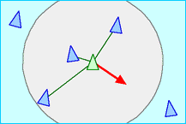
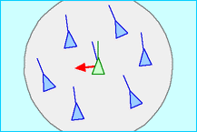
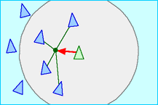
Autonomous Group Control Philosophy
Reynolds’ Concepts | Concept definition | Demo | As interpreted within the USW
Collision Avoidance | Avoid collisions with nearby flock-mates. |  | Each WO will have a unique name (a URI).
Velocity Matching | Attempt to match velocity with nearby flock-mates. |  | Resources use: as many resources as those in your “flock.”
Flock Centering | Attempt to stay close to nearby flockmates. |  | Copies of a WO are near other WOs of the same “flock”; the preserved copy of a WO will only exist on a host known by a member of the flock.
http://www.red3d.com/cwr/boids/

Slide 14
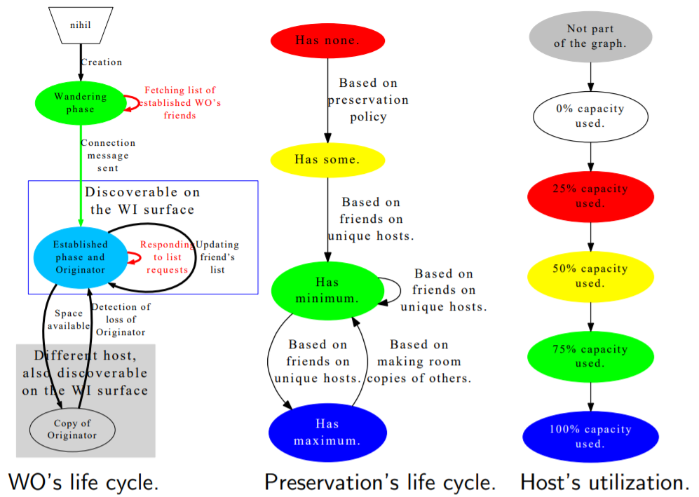
Life Cycle

Slide 15
Future work
Communication costs: Not only to reduce the number of messages that are sent during the different phases of a WO’s life, but also defining what is the “best” communications mechanism.
Graph theory: Dealing with the actions that a USW graph must take when a previously disconnected graph elects new parent WOs and then becomes connected.
Information retrieval: USW WOs will live a long time, but they have not fulfilled their purpose if their payload remains undiscovered and unretrieved.
Self modifying software: USW WOs will live a long time, and it is reasonable to assume that the language that the original USW scripts were written in will become extinct. Therefore the scripts must be able to evolve to new languages and new capabilities.

Slide 16
References
Chuck Cartledge (2014) “A Framework for Web Object Self-Preservation”

